Slide 1

NADRA KIOSK
by:
NC Zainab Abbas
NC Manahil Zahid
NC Aasma Hashim

Slide 2


Slide 3
Topics Distribution
NC Zainab Abbas:
  Introduction and overall description
  Two of the system features
NC Manahil Zahid:
  Remaining four of the system features
  Hardware interfaces of the system
NC Aasma Hashim:
  Non-functional requirements
  Analysis models (class and activity diagrams)

Slide 4
Introduction

Slide 5
Purpose
The proposed system is meant for the NADRA organization and its customers. NADRA KIOSK is database handling system that provides single and efficient computer terminal with all the services unlike the present distributed system which have separate terminals for sub-tasks. That single computer terminal shall provide services of registering new records, issuance of CNIC cards, renewal of expired ones and modification facility.

Slide 6
Project Scope
Our system will provide electronic registration facility to the customers of NADRA.
The proposed system will save customers time as compared to current system where customers have to stand in long queues.
The proposed system integrates the sub-tasks required in a complete registration process by providing a single terminal taking customers’ data reducing employees fatigue as well.

Slide 7
Product Perspective
Our system provides a total new solution, which is a kiosk, for the registration of individuals at National Database and Registration Authority System. It has no earlier versions of its kind. Certain subsystems shall support our proposed system for its proper functioning. Our system doesn't work independently, it has to access the National Database and manipulate it, if required.

Slide 8
Main Features
The system shall allow the new users to register themselves at the National Database and Registration Authority system by applying for new CNIC.
It shall allow the user to view his personal information saved in the database and edit it, in case of change of status by using the feature of ‘edit information’.
It shall allow the user to report for lost or expired CNIC with the help of ‘report’ option.
The system shall give the admin a right to access and manipulate the database.

Slide 9
User Classes
Customer: Customer is the one who requests for issuance of new CNIC or editing or upgrading the current CNIC. The system shall be easy to use for customers of different levels of education.
Administrator: Administrator is responsible for monitoring and maintaining the database and the overall system. He/she shall be an expert using the system and accessing the database.

Slide 10
User Classes
Training Person: Training person will demonstrate a way to use the kiosk system for the new customers. They shall be having complete knowledge about the interfaces and its use.
Installation Technician: The initial installation shall be done by a Technician. He/she shall make the system work as expected in that environment. Moreover, the tasks related to the maintenance and repairing hardware or software shall also be the job of the technician. He/she shall be having the complete domain knowledge of the system.

Slide 11
Operating Environment
Software Platform:
Operating System: Windows XP Pro for Embedded Systems.
It provides scalability and is sufficient for integrating the proposed product features.
Hardware Platform:
Kiosk Hardware platform shall be used for the product, with the following specifications:
  Width: 16 inches
  Depth: 22 inches
  Height: 56 inches
  Weight: 206 pounds

Slide 12
Design and Implementation Constraints
Oracle Database Management system will be used for records.
The system coding will be done in C++ language with object-oriented methodology.
The system will take input via alpha-numeric keypad with minimal use of touch screen.
The system would be using a 5 megapixel camera and finger print reader for input and verification.
Large central storage is needed to follow the clustered approach

Slide 13
Assumptions and Dependencies
It is assumed that our system is provided with constant power supply at operational time and it has an unbroken connection with the Database.
User authentication procedure shall be used to protect data base from unauthorised access.
Also, network connection with the Database is assumed to be protected under the existing security policies applied by NADRA.
A backup of Database is maintained regularly, so as to restore it in case of failure.

Slide 14
System Features

Slide 15
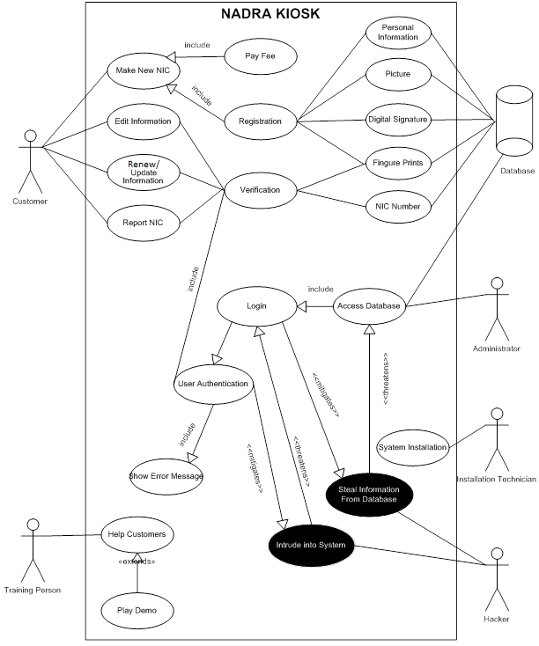
Use case Diagram

Slide 16
Request for a New CNIC
Stimulus and Response Sequence:
Customer selects ‘Make New CNIC’ option.
System asks for personal information including b-form number and CNIC number of parents.
System verifies information from parents CNIC number.
System asks for finger prints and signature .
Customer provides finger prints using finger print reader and signature through digital signature capture device.

Slide 17
6) System takes input successfully and asks
customer to fill the form for other personal
data.
7) Customer fills the form and submits.
8) System then prompts a message asking the
customer to look into the camera for picture.
9) System captures the picture and saves
customer record in the database.
10) System notifies the customer that his/her
record has been successfully registered and
the customer can collect CNIC on the
specified date.

Slide 18
Functional Requirements
FR #1: The system shall display the option for this feature which shall be accessed by the user.
FR #2: The system shall acquire and process the input information (personal info, finger impressions, picture etc.) given by the user through the input devices.
FR #3: The system shall acquire the user’s signature twice for confirmation.
FR #4: The system shall be able to identify valid users.
FR #5: The system shall be able to check if the input data is correct or not.
FR #6: The system shall prompt a message for wrong inputs and errors.
FR #7: The system shall save the correct data in the database as user record.

Slide 19
Request for Editing CNIC
Stimulus and Response Sequence:
  Customer selects the option ‘Edit Information’.
  System prompts to insert the CNIC.
  Customer inserts CNIC in the card reader.
  System asks for finger prints for verification.
  Customer provides finger prints.
  System verifies the finger prints.
  System provides a form to the customer to enter the information which is to be edited.
  Customer enters the changed data and submits the form.

Slide 20
System successfully updates the information in
database and drops the CNIC in a separate
chamber which is, the card collector, for
further processing.
10) System prompts a message telling the
customer to collect his/her edited CNIC at the
specified date.

Slide 21
Functional Requirements
FR #1: The system shall display the option for this feature which shall be accessed by the user.
FR #2: The system shall acquire the input information and process it, given by the user through the input devices.
FR #3: The system shall be able to identify valid users.
FR #4: The system shall be able to check if the input data is correct or not.
FR #5: The system shall prompt message for wrong inputs and errors.
FR #6: The system shall save the edited data in the database as user record.
FR #7: The system shall acknowledge the success of the entire process and gives out a receipt for user’s record.

Slide 22
by: NC Manahil Zahid (onwards)

Slide 23
Request for Renew/Update CNIC
Stimulus and Response Sequence:
  Customer selects the option ‘Update CNIC’.
  System prompts to insert the CNIC.
  Customer inserts CNIC in the card collector.
  After validating the card, system asks for CNIC number and finger prints.
  Customer provides both.
  System verifies finger prints and validates user.
  System prompts a message and drops the CNIC in a chamber for disposal.
  System prints out a receipt, informing the user about the date to collect the card.

Slide 24
Functional Requirements
For Renew/Update Card:
FR #1: The system shall display an accessible and operational option for the feature.
FR #2: The system shall be able to identify valid users by matching the finger prints.
FR #3: The system shall have a check for wrong inputs and errors.
FR #4: The system shall acknowledge the success of the entire process and gives out a receipt for user’s record.

Slide 25
Report for Lost CNIC
Stimulus and Response Sequence:
  Customer selects the ‘Report CNIC’ option.
  Customer enters CNIC number.
  System asks for user’s finger prints.
  Customer provides finger prints.
  System verifies finger prints and validates user.
  System asks for user’s signature.
  User inputs the signature twice through the digital signature capture device.
  System prints out a receipt, informing the user about the date to collect the card.

Slide 26
Functional Requirements
For Lost Card:
FR #1: The system shall display an accessible and operational option for the feature.
FR #2: The system shall be able to identify valid users by matching the finger prints.
FR #3: The system shall process the signatures given by the user. First matches the two signatures, then saves it.
FR #4: The system shall have a check for wrong inputs and errors.
FR #5: The system shall acknowledge the success of the entire process and gives out a receipt for user’s record.

Slide 27
Request to Access Database
Stimulus and Response Sequence:
System asks the admin for username and password.
Administrator provides username and password.
System verifies username and password and asks for finger prints.
Administrator provides finger prints.
System verifies the finger prints.
System provides access to database after complete verification.
Administrator successfully logs in and gets an access to database.
Administrator views records and request lists.

Slide 28
Functional Requirements
For Lost Card:
FR #1: The system shall display an accessible and operational option for the feature.
FR #2: The system shall be able to identify valid admin by asking username and password.
FR #3: The system shall ask for admin’s finger prints and process it.
FR #4: The system shall have a check for wrong inputs (username and password) and errors.
FR #5: The system shall provide an access of database to admin and a right to manipulate on complete verification.

Slide 29
Help Feature
Employee shall provide help:
verbal instructions
playing video demo
The user shall ask for help:
To the employee
Instructions in text form
video demo

Slide 30
Functional Requirements
For Help feature:
FR #1: The system shall display an accessible and operational option for the feature.
FR #2: The system shall be able to play a video if requested by the user.
FR #3: The system shall provide help in text form if requested by the user.

Slide 31
External Interface
Requirements

Slide 32
External Interface Requirements
User Interfaces
Hardware Interfaces
Software Interfaces
Communications Interfaces

Slide 33




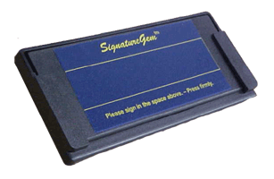
1. User Interfaces
i. LCD Screen:
  System status
  Help icon
  Error messages
  Back button
  Every control with a meaningful text
ii. Signature Capture Device:
  User gives signature in
  a particular marked area
  Sign with help of Stylus

Slide 34
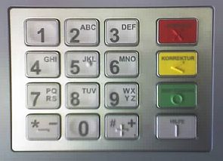
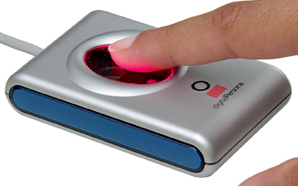
1. User Interfaces (cont.)
ii. Photographic Camera:
User needs not to interact with it as such.
iii. Alpha-numeric keypad:
  For entering data
  Rough and tough
  Common to masses
iv. Finger Print Reader:
  as user’s record
  for verification

Slide 35
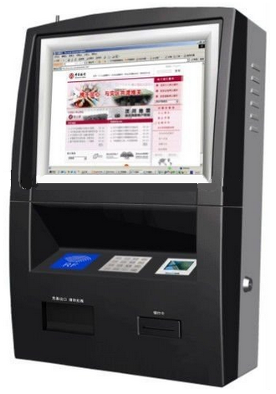
2. Hardware Interfaces
i. The Terminal (kiosk):
Width: 16 inches
Depth: 22 inches
Height: 56 inches
Weight: 206 pounds
ii. LCD screen:
8 inch diagonal with
512 x 512 resolution
Eight function keys for
menu selection
Displays up to 12
graphics screens

Slide 36
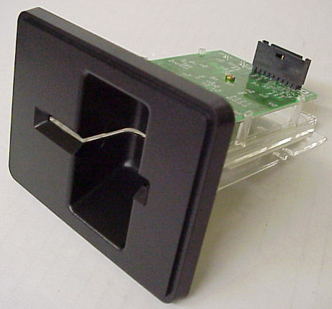
2. Hardware Interfaces (cont.)
iii. Alpha-numeric keypad:
16 keys
0 – 9 for numeric entry
Left and right arrows
Enter, Clear, Cancel
iv. Card Collector:
Type of a card skimmer
in an ATM
Verifies the NADRA card
and drops in a box

Slide 37
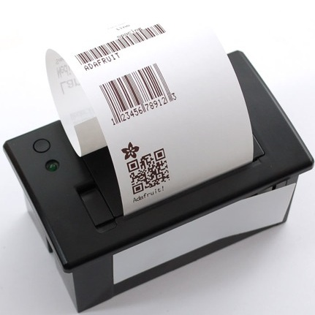
2. Hardware Interfaces (cont.)
v. Receipt Printer:
2 inch thermal printer
Automatic paper
loading and cutting
Paper out status sensor
vi. Fingerprint Reader:
Height 3.56.1 inches
Width 63.5 inches
Depth 1 inch
Weight: 1 pound
Dry Contact Relay

Slide 38

2. Hardware Interfaces (cont.)
vii. Embedded Camera
5 megapixel
Optical and digital
zoom
viii. Signature Capture Device:
Dimensions:
6.4”(w) x 2.8” (h) x 0.5”
Signing Area:
4.8” x 1.2”
Resolution:
410 points per inch

Slide 39
3. Software Interfaces
Operating System: Windows XP Embedded
Application Programming Interface (API) WOSA/XFS:
  It provides a common API for accessing and manipulating the various devices of a kiosk based system.
  Client-Server architecture on a windows platform.
Database: Oracle Database Management System.

Slide 40
4. Communication Interfaces
The system shall be working with two Secured Wide Area Network (WAN) systems
A wireless communication system
Optical Fiber medium based communication system.

Slide 41
Non-Functional
Requirements by: NC Aasma Hashim (onwards)

Slide 42
Non-Functional Requirements
Performance Requirements
Safety Requirements
Security Requirements
Software Quality Attributes
Analysis Models
System Class Diagram
Activity Diagram for New CNIC
Activity Diagram for Update CNIC
Activity Diagram for Access Database

Slide 43
Nonfunctional Requirements
Performance Requirements
The response time of the system shall be less than 5 seconds.
The system shall generate an error message.
The system shall be able to respond to multiple user requests.
The system shall use multiple threads execution technique.
2. Safety Requirements
The system shall have a back or undo option.
The system shall have a database backup.

Slide 44
3.Security Requirements
The database access rights are decided keeping forth who is going to use the system.
The system shall verify the admin.
The database shall be protected.
4. Software Quality Attributes
Availability
Effectiveness
Fault-Tolerance
Flexibility
Usability
Maintainability
Security

Slide 45
Analysis Models

Slide 46
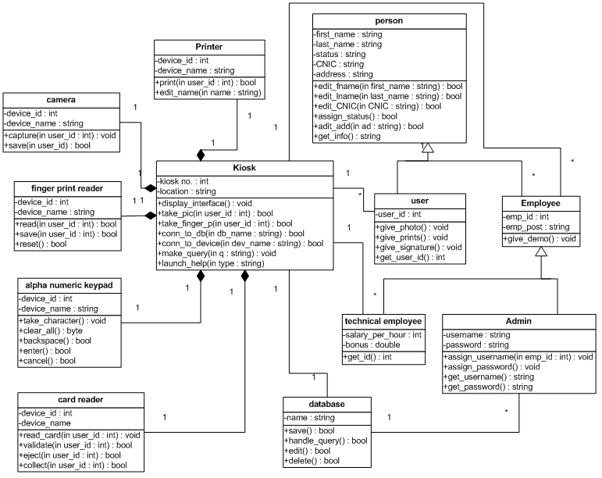
System Class Diagram

Slide 47
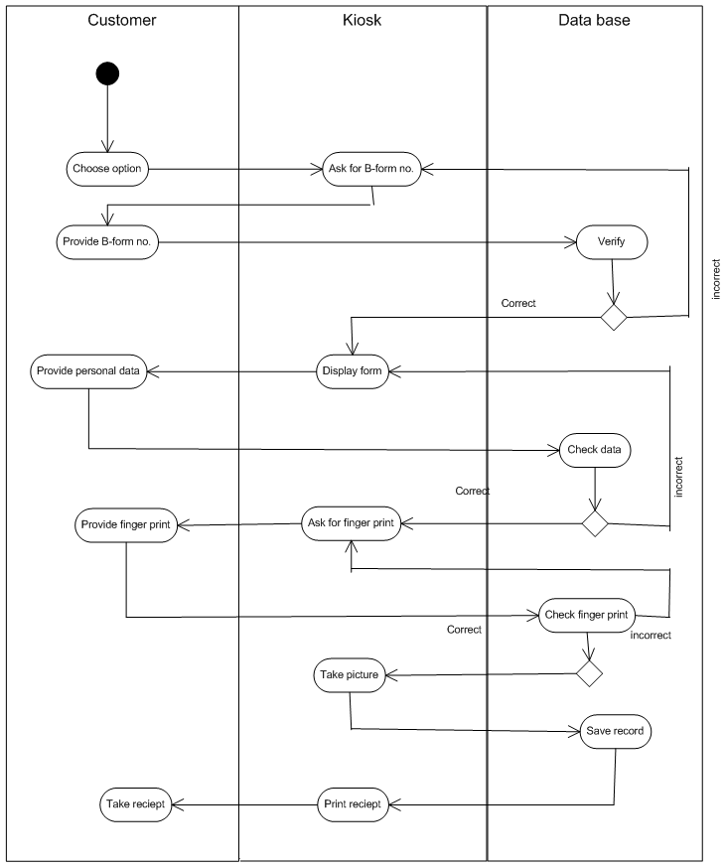
Activity diagram: new CNIC

Slide 48
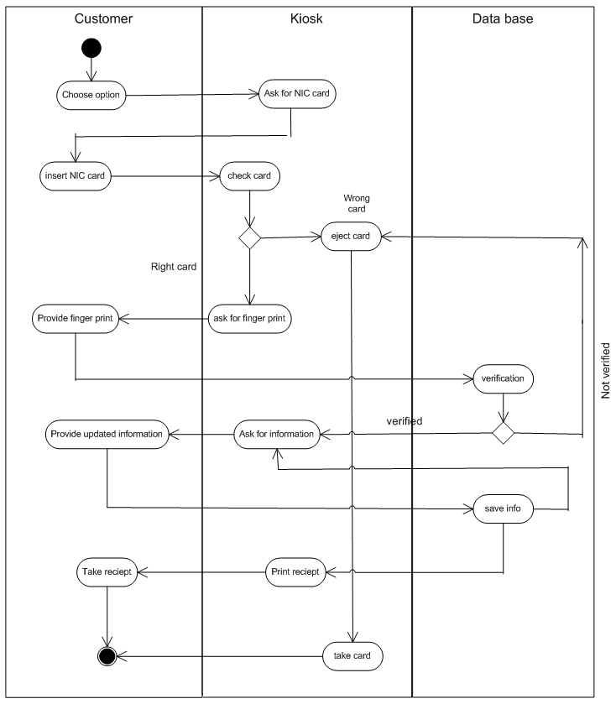
Activity diagram: Update CNIC

Slide 49
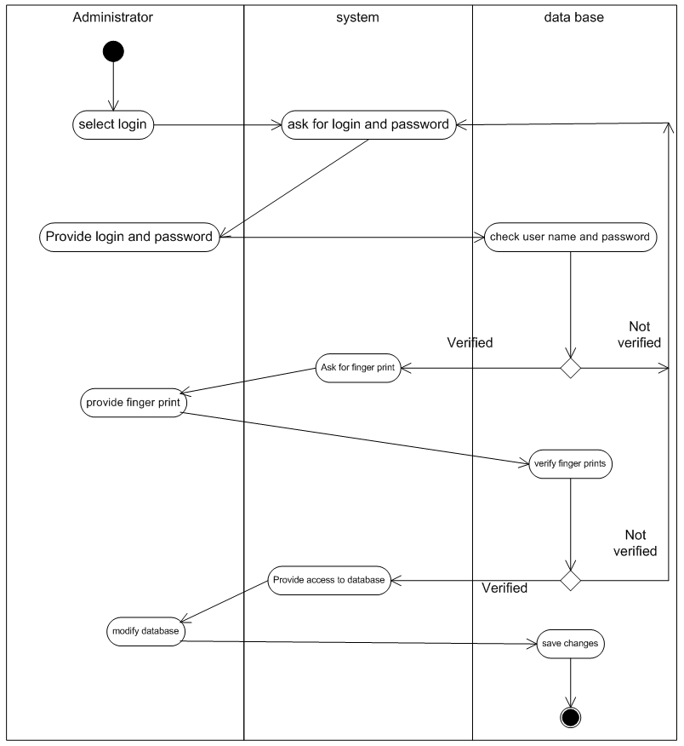
Activity diagram: Access Database

Slide 50
Thank You! ☺

